Slide 1
Essentials of Alignment: Safer Together: A National Action Plan to Advance Patient Safety and the CMS Patient Safety Structural Measure
IHI Patient Safety Learning Series: Session 1
April 30, 2025

Slide 2
Disclosure
Patricia McGaffigan is a Board Member of the I-PASS Institute. Helen Macfie is an I-PASS Institute Coach.
Any relevant financial relationships listed have been mitigated.
None of the other planners, presenters, or staff for this educational activity have relevant financial relationship(s) to disclose with ineligible companies whose primary business is producing, marketing, selling, re-selling, or distributing healthcare products used by or on patients.​

Slide 3
Continuing education credits
In support of improving patient care, the Institute for Healthcare Improvement is jointly accredited by the Accreditation Council for Continuing Medical Education (ACCME), the Accreditation Council for Pharmacy Education (ACPE), and the American Nurses Credentialing Center (ANCC), to provide continuing education for the healthcare team.
This activity is approved to provide 1 credit for physicians, nurses, and Certified Professional in Patient Safety (CPPS) recertification.
Instructions to claim continuing education credits will be provided following today's program.

Slide 4
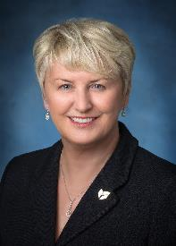
Your IHI Safety Experts
Patricia McGaffigan, MS, RN, CPPS
Learning Series Facilitator
Senior Advisor, Safety & President, Certification Board for Professionals in Patient Safety, IHI; IHI Fellow; Champion, Patients for Patient Safety, US; Co-Chair, National Steering Committee for Patient Safety
Helen Macfie, Pharm.D., FABC
Guest Presenter
IHI Fellow; IHI Faculty;
Champion, Patients for Patient Safety, US; Past Chief Transformation Officer, MemorialCare; Member, National Steering Committee for Patient Safety

Slide 5
Welcome to today’s Patient Safety Webinar!
Session Objectives
Review key takeaways from and alignment with Safer Together: A National Action Plan to Advance Patient Safety and the CMS Patient Safety Structural Measure
Identify methods to align your patient safety work with national priorities
Today’s Agenda
Checking in – your familiarity, where you’re at, and what you’d like to know
Level-setting and cross-walking the National Action Plan and Patient Safety Structural Measure
Key issues and opportunities
Next steps for IHI Learning Series
Notes:
[5 min] Aim, agenda, (1) virtual discussion prompt based on aim for the session call

Slide 6
Get Ready for Polling!

Slide 7
My familiarity with the Safer Together Organizational Assessment Tool...

Slide 8
My familiarity with the CMS Patient Safety Structural Measure...

Slide 9
Our organization's progress on the NAP and/or PSSM...

Slide 10
What’s on Your Mind Today?
Please Chat:
Your name, organization and role
What is the key question on your mind today to help you successfully navigate the National Action Plan and/or the Patient Safety Structural Measure?
Notes:
[5 min] Aim, agenda, (1) virtual discussion prompt based on aim for the session call

Slide 11
“Current” State
25!
https://www.ihi.org/resources/publications/free-harm-accelerating-patient-safety-improvement-fifteen-years-after-err
https://pubmed.ncbi.nlm.nih.gov/25077248/
https://www.barnesandnoble.com/w/still-not-safe-robert-wears/1130750619
Notes:
[10 min] Session core content overview
*Brief didactic
Patricia

Slide 12
From Incremental to Transformational
What will it take to move from incremental and often unstable improvement in safety to transformational, durable safety?
Notes:
Patricia

Slide 13
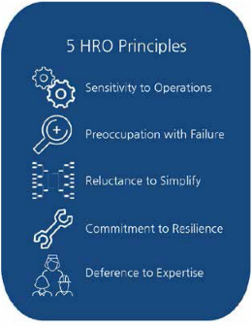
The Critical Shift
Reacting to harm
Preventing harm -proactive risk mitigation
“Fixing humans”
Improving systems & cultures to optimize human performance
Safety as projects
Safety as nonnegotiable core value; purpose
Notes:
Patricia

Slide 14
On Total System Safety
Notes:
Patricia

Slide 15
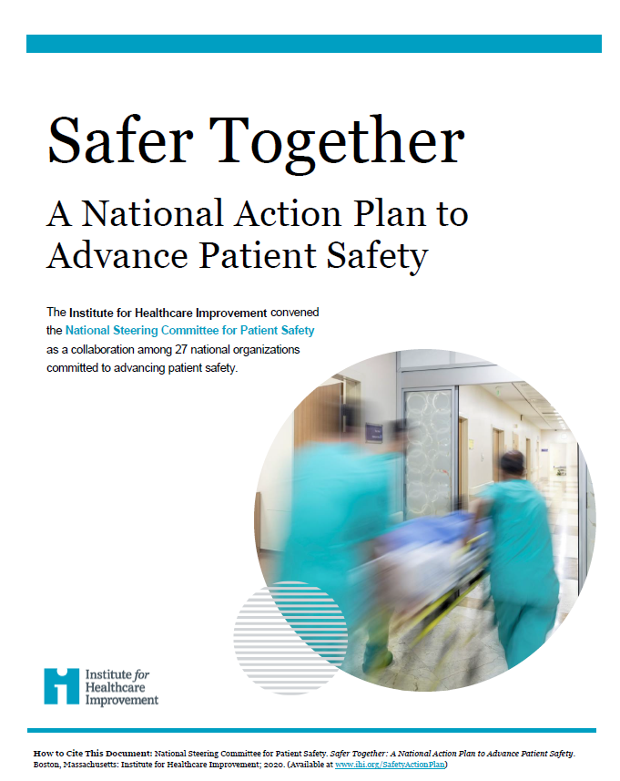
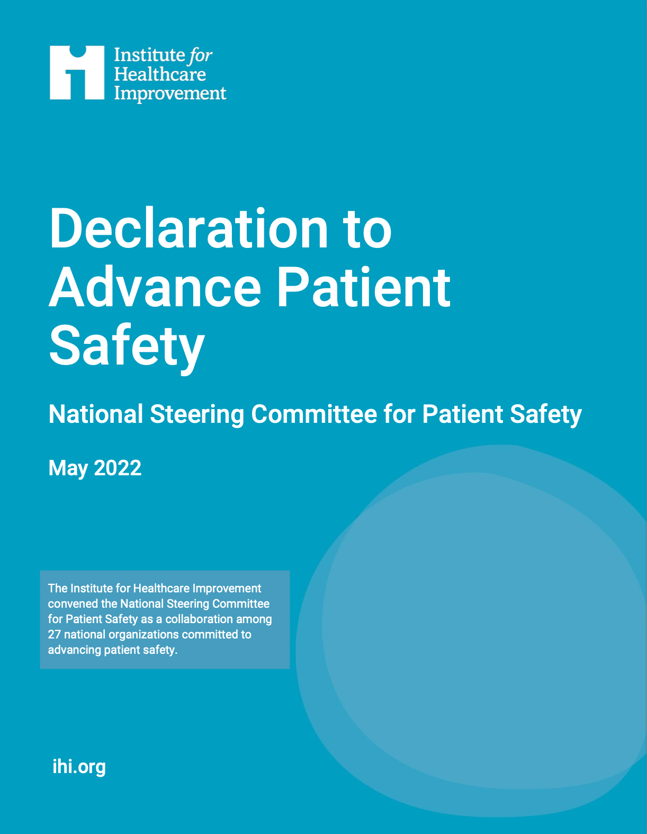
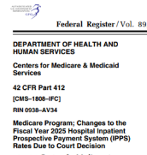
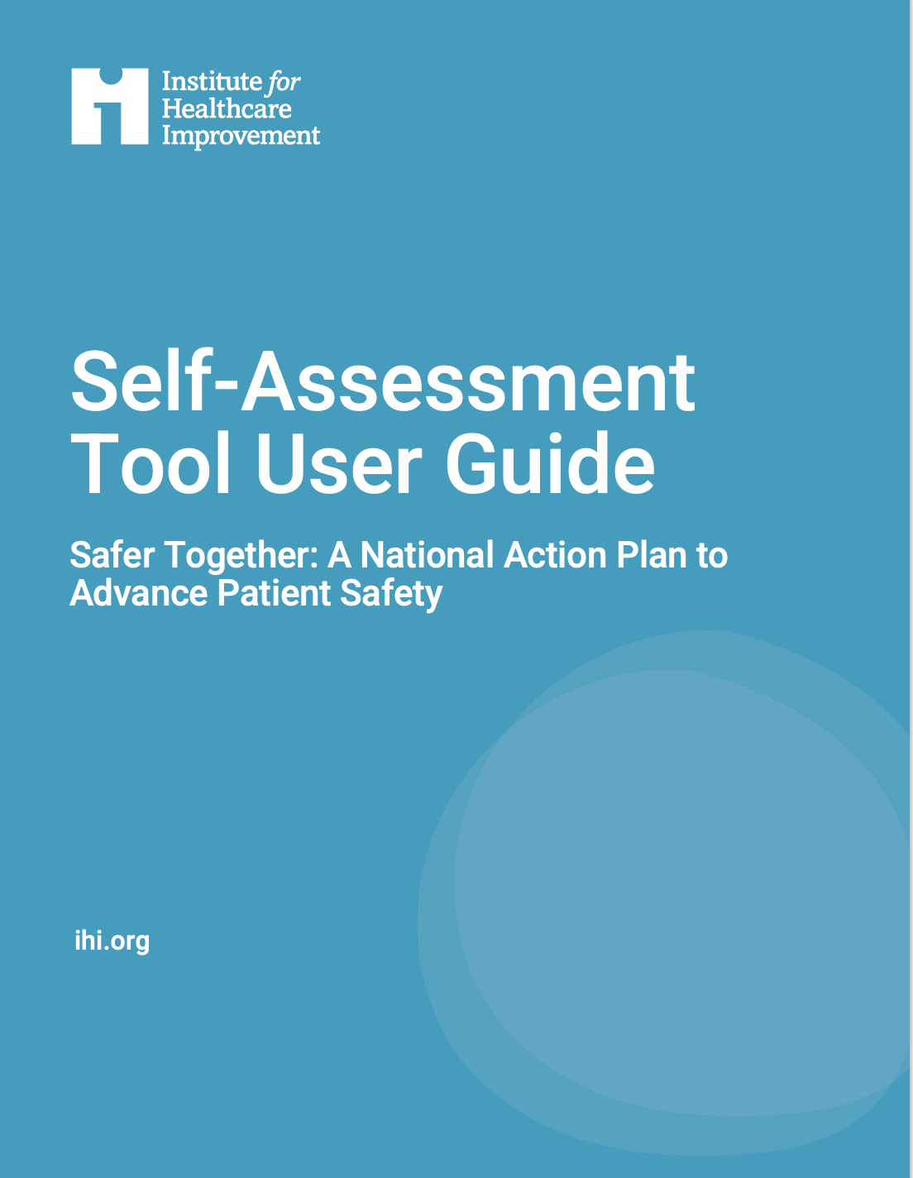
Key Initiatives
2018
IHI Convenes National Steering Committee for Patient Safety
2021
WHO Global Patient Safety Action Plan
2023
HHS National Action Alliance for Patient and Workforce Safety
Dec 2024
Updated National Action Plan Self-Assessment and User Guide
May 2022 Declaration To Advance Safety
Aug 2024
CMS Patient Safety Structural Measure
Sept 2020
Safer Together Released
Notes:
Patricia

Slide 16
Safer Together: A National Action Plan to Advance Patient Safety

Slide 17
About Safer Together: A National Action Plan
Focus | Foundational areas deemed important for safety with emphasis on systems-based approach to safety; based on most salient, evidenced-based elements of safety
Alignment | CMS Patient Safety & Equity Structural Measures; HHS National Action Alliance for Patient & Workforce Safety; CMS National Quality Strategy; WHO Global Safety Action Plan
Applicable to | Any care setting
Data/Scoring | Executive-sponsored team completes assessment; repeat annually Four foundational areas: Culture, Leadership, and Governance; Patient and Family Caregiver Engagement; Workforce Safety and Wellbeing; Learning system
Timing & Impact | Released in 2020; Organizational Assessment Tool updated in 2024 Increased use in diverse care settings across continuum of care; hospital associations Measurable improvements in scores year to year
Notes:
Helen

Slide 18
Safer Together: A National Action Plan
Culture, Leadership & Governance
Learning
System
Workforce Safety & Well-being
Patient, Family & Caregiver Engagement
Person-Centered Care
Care Across the Entire Continuum
Relationship Between Patient Safety & Health Equity
www.ihi.org/SafetyActionPlan

Slide 19
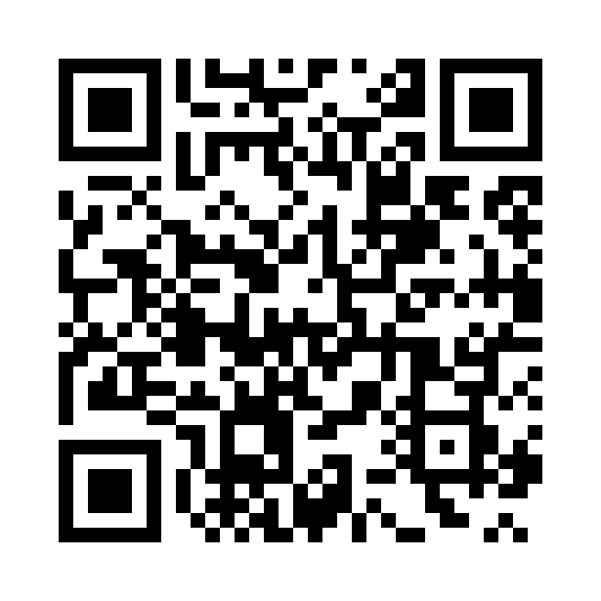
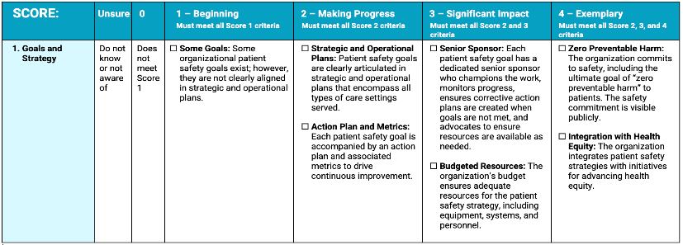
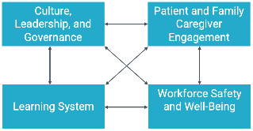
Newly Updated Self-Assessment Tool
Notes:
Helen

Slide 20
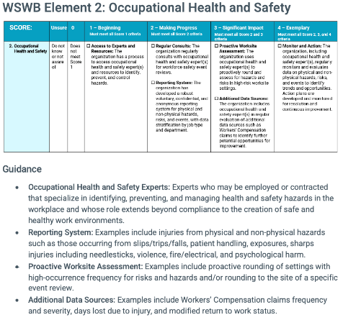
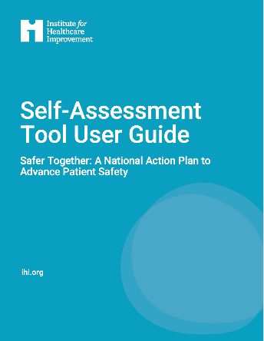
User Guide
NEW!
National Steering Committee for Patient Safety. Self-Assessment Tool User Guide — Safer Together: A National Action Plan to Advance Patient Safety. Boston: Institute for Healthcare Improvement; 2024. (Available at ihi.org)
Notes:
Helen

Slide 21
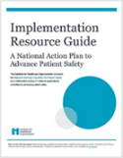
Safer Together in Action
1. REVIEW the recommendations and tactics for the four foundational areas in Safer Together: A National Action Plan for Patient Safety.
2. IDENTIFY a senior sponsor and core team charged with deploying the Self-Assessment Tool to ASSESS your current state in each of the 4 areas.
3. ESTABLISH and ENACT strategies, tactics, and measurement and improvement plans by leveraging the Implementation Resource Guide.
www.ihi.org/SafetyActionPlan
Notes:
The Safer Together NAP includes three components, and the guidance we’ve provided for the NAP and in the declaration are for healthcare leaders to do three things associated with the components. First, to review the recommendations and tactics of the plan, second to identify a senior sponsor and core team charged with deploying the organizational self-assessment too to determine current state and third, to set goals for improvement and enact strategies, tactics, and measurement and improvement plans by leveraging the implementation resource guide. These are all freely available on the IHI website. Next slide

Slide 22
CMS Patient Safety Structural Measure

Slide 23
About the CMS Patient Safety Structural Measure
Focus | Foundational areas important for safety; identifies hospitals practicing a systems-based approach; domains reflect salient, evidenced-based, structural and cultural elements
Alignment | Aligns with Safer Together: A National Action Plan to Advance Patient Safety; HHS National Action Alliance for Patient and Workforce Safety; CMS National Quality Strategy
Applicable to | Acute care hospitals paid under the IPPS & 11 PPS Exempt cancer hospitals Excludes statutorily exempted children’s, inpatient psychiatric, long-term care, rehabilitation hospitals
Data/Scoring | Attestation-based; scores range from 0-5 5 domains; must respond yes to each element/activity to achieve a full point
Timing & Impact | CY 2025: First reporting period with attestation submitted in April-May 2026 Oct 2026: Scores publicly reported on CMS Care Compare Oct 2026 (FY 2027): Hospitals that fail to report face reductions in their annual Medicare payment
Notes:
Helen

Slide 24
PSSM Domains and Intent
Domain | Intent
1. Leadership Commitment to Eliminating Preventable Harm | Addresses the importance of senior leadership and the governing board setting the tone for commitment to patient safety and the essential leadership practices for safety.
2. Strategic Planning and Organizational Policy | Addresses how hospitals use their strategic planning cycles and internal policies to demonstrate a commitment to safety.
3. Culture of Safety and Learning Health System | Addresses whether hospitals integrate evidence-based practices and protocols that are fundamental to cultivating a safety culture and learning system within and across hospitals.
4. Accountability and Transparency | Supports accountability for outcomes and transparency around safety events and performance – cornerstones for safety.
5. Patient and Family Engagement | Supports the effective and equitable engagement of patients, families, and caregivers in their own care and in the co-design of safe systems.
For more on the PSSM and the PSSM Attestation Guide: https://qualitynet.cms.gov/inpatient/iqr/measures#tab2

Slide 25
Expanded Self-Assessment Elements & SM Linkage
Culture, Leadership, and Governance | Patient and Family Caregiver Engagement | Workforce Safety and Wellbeing | Learning System
Goals and Strategy | Patient and Family Advisory Council Engagement in Patient Safety | Goals and Strategy | Safety Curriculum
Fair and Just Culture | Patient-Care Team Open Communication | Occupational Health and Safety | Safety Learning Networks
Communication of Patient Safety Events | Care Plan Engagement | Violence Prevention | Health Equity Data
Patient Safety Culture Surveys | Escalation of Safety Concerns | Well-Being and Joy in Work | Safety Goals Deployment
Job / Role Descriptions | Communication and Resolution Program (CRP) | Communication of Workforce Safety Events | Safety Event Reporting and Review
Performance Reviews | Medical Records Access | Job / Role Descriptions | Safety Event Transparency
Leadership and Governance Practices | Engagement in Safety Improvements | Performance Reviews
http://www.ihi.org/SafetyActionPlan
SM = CMS Structural Measure
Notes:
Helen

Slide 26
What do Safer Together and the PSSM have in common? A lot, plus:
Safer Together National Action Plan | Patient Safety Structural Measure Domain 1-Statement B
Safer Together: A National Action Plan to Advance Patient Safety provides concrete guidance for leaders to assess and fortify their total systems approach to safety by addressing specific needs and capabilities that enable safe care. We (the NSC) call upon every health care leader across the continuum of care to recommit to advance patient and workforce safety by deploying the National Action Plan in their organizations. | One or more C-suite leaders oversee a systemwide assessment on safety and the execution of patient safety initiatives and operations, with specific improvement plans and metrics. These plans and metrics are widely shared across the hospital and governing board. “System­-wide assessment on safety” refers to a hospital self-­assessment of safety practices and capacity, such as the Institute for Healthcare Improvement’s (IHI) Self-Assessment Tool that accompanies the (Safer Together) National Action Plan to Advance Patient Safety
Notes:
Helen

Slide 27
5 Whys
The National Action Plan and Self-Assessment Tool 2024 Update are applicable to all healthcare settings.
The Self-Assessment Tool provides a psychologically safe organizational assessment and roadmap for improvement in patient and workforce safety.
Engagement and team-building for your leadership team in patient and workforce safety.
The NAP Self-Assessment and User Guide offer definitions, considerations and examples for advancing to the next level.
One attestation element of the PSSM addresses completion of a system-wide assessment on safety by the end of 2025.
The National Action Plan + the Patient Safety Structural Measure

Slide 28
Making it happen…
Notes:
[10-min] Using 1-2 predetermined prompts, open discussion ; between guest presenters, facilitator, and invite chat questions, comments

Slide 29
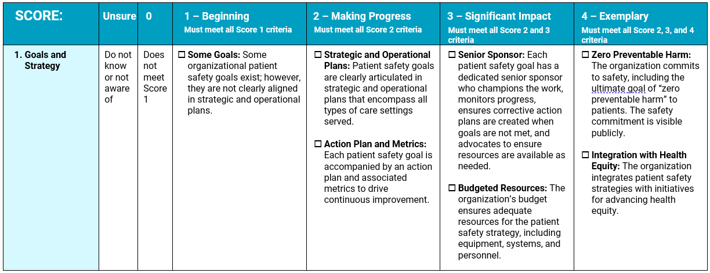
PSSM Challenges “vs” NAP Roadmap: CLG
Focusing in on PSSM Statements | Key Discussion Questions/Challenges (Review of Attestation Guide where noted)
1C: Our hospital governing board, in collaboration with leadership, ensures adequate resources to support patient safety (such as equipment, training, systems, personnel, and technology). | Attestation Guide: no additional notes Tangible ways to track this? How to evidence, examples. Escalation from frontline team needs up? Not required to meet PSSM but great to do. Leveraging tiered huddles, follow-through, tracking systems.
NAP SA 2024 User Guidance:
Goals: Patient safety goals target opportunities for improving safety and reducing harm and should be aspirational yet actionable, with specific measurable objectives. Each goal must include an aim statement with a bold or stretch target (“how much”) and a specified timeframe for achievement (“by when”). Examples:
Zero Preventable Harm: This aligns the National Action Plan and with the World Health Organization, US Department of Health and Human Services, and Centers for Medicare & Medicaid Services (CMS) strategies to publicly commit to the long-term and ultimate goal to reduce preventable harm to patients.
Publicly Visible: Refers to a public declaration both internally (within the organization) and externally (patients and the broader community). Examples include website, bulletins, storyboards, patient resources, and marketing materials.
Notes:
3) (7 min) What's Worked Well - keys to success in PI (pick up on their project themes), BOLD goals, understanding data over time (not blocks, SPC prn), patient-focused/stories, intentionality / "relentless" passion for patient safety

Slide 30
The National Action Plan and/or PSSM area that we find most challenging and would like additional support...

Slide 31
Please identify any specific areas of interest for Session 2: Culture, Leadership, and Governance practices:

Slide 32
Actions to Consider
Familiarize yourself and your leaders with the National Action Plan & the PSSM
Conduct an organizational assessment to identify current state & opportunities
Join future Learning Series sessions to advance learning and community building

Slide 33
Core IHI Resources
Domains
1: Leadership Commitment to Eliminating Preventable Harm NAP Online Assessment Tool Leading a Culture of Safety: A Blueprint for Leaders Framework for Effective Governance of Health System Quality
2: Strategic Planning & Organizational Policy Open School; Patient Safety Executive Program, CPPS Certification
3: Culture of Safety & Learning Health System Leading A Culture of Safety: A Blueprint for Leaders RCA2 Toolkit & Online Course with Coaching; Model for Improvement, PDSAs; Patient Safety & QI Essentials Toolkits Certified Professional in Patient Safety (CPPS) and Human Factors in Healthcare (CPHFH) programs Care Operating System
4: Accountability & Transparency Communication and resolution program (e.g., CANDOR) Lucian Leape Institute Transparency Report
5: Patient & Family Engagement Ask Me 3, The Conversation Project, What Matters to You, Age Friendly Care & Certification, Always Event Toolkit

Slide 34
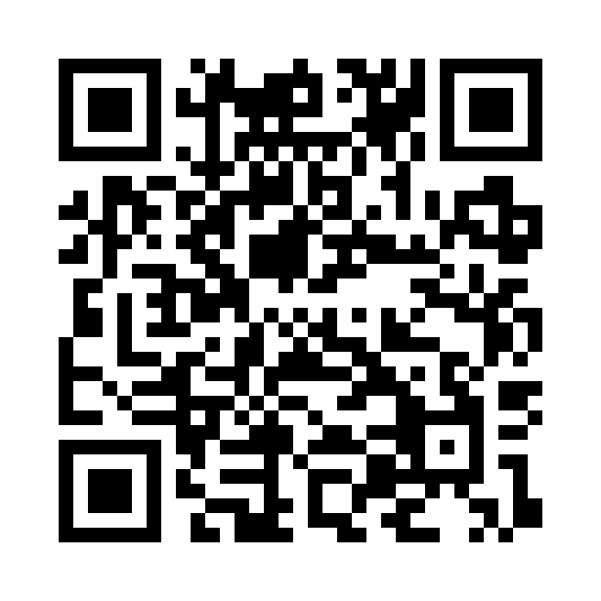
IHI Patient Safety Learning Series
Next Session: Understanding the Impact of Culture, Leadership, and Governance on Safety
June 25, 1:00 PM–2:00 PM ET
Full Series registration now available!

Slide 35
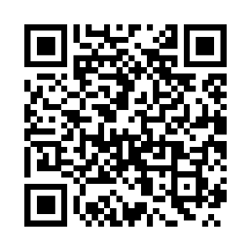
Your Commitment to Safety Deserves Recognition
The IHI Safer Together Recognition Program highlights organizations that are leading the way in safety culture and best practices.
ihi.org/SaferTogetherRecognition

Slide 36
With gratitude for all you do to keep patients and those who care for them free from harm…
pmcgaffigan@ihi.org
hmacfie1@gmail.org

